Slide 1



Connecting Battery Technologies for Electric Vehicles
Presenter: Your Name

Slide 2


Section 1
Overview of Battery Technologies in Electric Vehicles

Slide 3

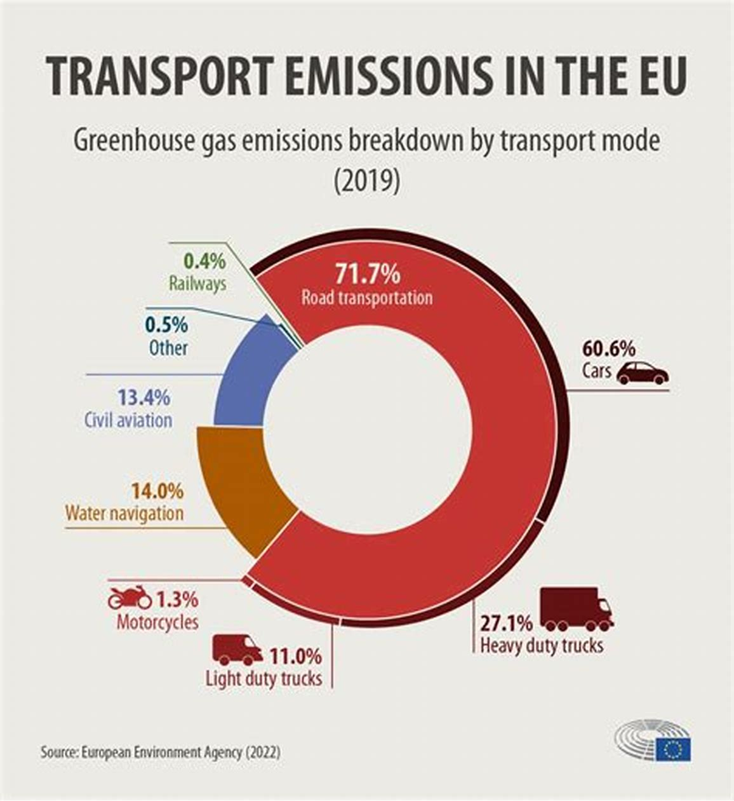
Importance of Vehicle Electrification
Environmental Sustainability
Vehicle electrification significantly reduces greenhouse gas emissions, contributing to cleaner air and lower urban pollution levels, especially when powered by renewable energy sources, thus supporting global climate change mitigation efforts.

Slide 4


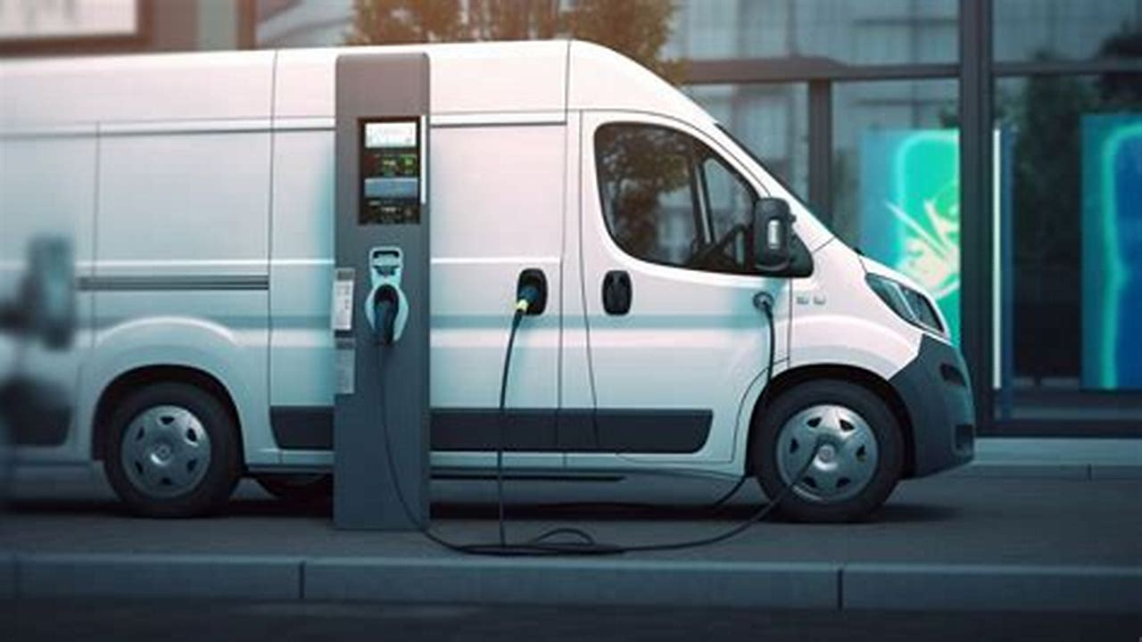
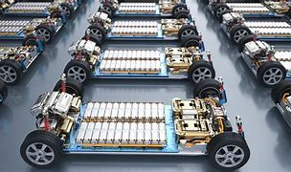
Types of Battery Technologies
Conventional Battery Overview
Lithium-Ion Advancements
Future Innovations
Lead-acid and nickel-based batteries serve as foundational technologies, offering reliability and cost-effectiveness, yet face limitations in energy density and weight for modern electric vehicle applications.
Lithium-ion batteries dominate the current market due to their high energy density and versatility, with ongoing research into improved materials enhancing performance and sustainability in electric vehicles.
Emerging technologies like all-solid-state and silicon-based batteries promise to revolutionize energy storage, addressing safety concerns and increasing energy capacity, thus supporting the future of electric mobility.

Slide 5
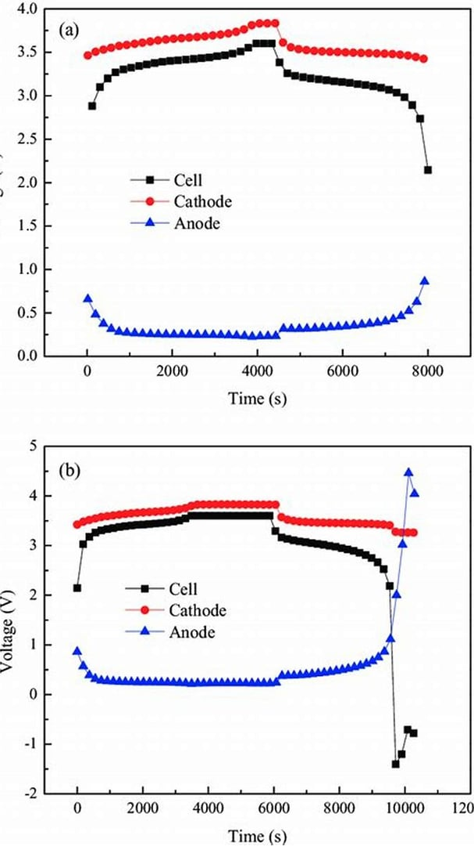
Key Components of Batteries
Cathode Functionality
Cathodes, including lithium transition metal oxides and lithium iron phosphate, are crucial for determining voltage and energy capacity, affecting the operational range and safety of battery systems.
Anode Material Selection
Electrolyte Role
The choice of anode material, such as graphite or silicon, directly impacts battery performance metrics like energy density and cycling stability, influencing overall efficiency in electric vehicles.
The electrolyte's composition, whether liquid, polymer, or solid-state, is vital for ion transport and overall battery safety, with advancements aimed at improving efficiency and reducing flammability risks.

Slide 6




Role of Battery Management Systems
02
01
03
Dynamic Charging Control
Continuous Health Monitoring
Integrated Safety Mechanisms
Algorithms within the BMS adjust charging rates based on real-time conditions, optimizing battery life and preventing damage from overcharging.
The BMS employs advanced sensors to track battery parameters, ensuring early detection of anomalies that could compromise safety and performance.
The BMS implements multiple safety protocols, including voltage and current limits, to protect against hazardous conditions and enhance overall battery reliability.

Slide 7
Section 2
Advancements in Battery Materials and Design

Slide 8


Conventional vs. Contemporary Battery Technologies
02
01
Conventional Battery Limitations
Contemporary Battery Advantages
Conventional batteries, such as lead-acid and nickel-based types, struggle with low energy density and weight, limiting their effectiveness in modern electric vehicle applications and overall performance.
Contemporary lithium-ion batteries offer superior energy density, efficiency, and longevity, making them the preferred choice for electric vehicles, with ongoing innovations promising further enhancements in performance and sustainability.

Slide 9

Innovations in Battery Components
Emerging Anode Technologies
The development of silicon-based and lithium metal anodes is crucial for enhancing energy density and cycle stability in batteries, addressing challenges like volumetric expansion and dendrite formation to improve overall battery performance and safety.

Slide 10
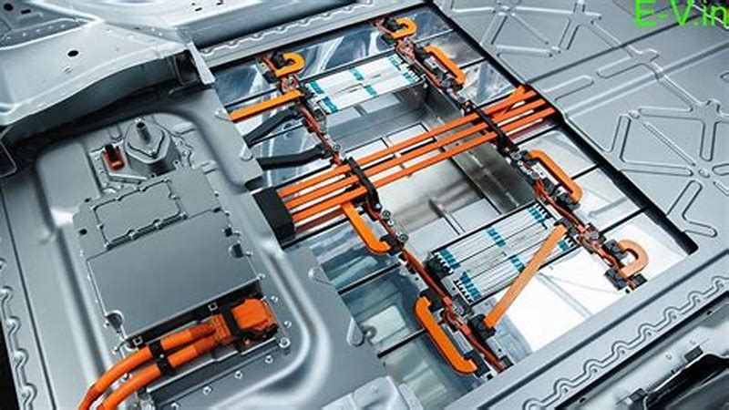


Future Battery Technologies
Advancements in Energy Density
Sustainability and Material Innovation
Safety and Stability Improvements
Future battery technologies aim to significantly enhance energy density, enabling electric vehicles to achieve longer ranges and improved performance, crucial for widespread adoption and consumer acceptance.
Research emphasizes the use of sustainable materials and eco-friendly manufacturing processes, aligning battery technology advancements with global sustainability goals and reducing environmental impact.
Innovations focus on enhancing safety features, such as reducing flammability risks and improving thermal stability, which are essential for building consumer trust in electric vehicle technologies.

Slide 11
Impact of Material Selection on Performance
02
01
Material Properties Influence
Sustainability and Lifecycle
The selection of materials directly affects battery performance metrics such as energy density, charge rates, and thermal stability, which are critical for optimizing electric vehicle efficiency and safety.
Choosing sustainable materials not only enhances performance but also addresses environmental concerns, promoting recyclability and reducing the ecological footprint of battery production and disposal in electric vehicles.

Slide 12
Section 3
Commercial Applications and Future Perspectives

Slide 13



Cost Reduction Strategies in Battery Production
Economies of Scale Impact
Increasing production volumes through gigafactories allows manufacturers to spread fixed costs over more units, significantly lowering per-unit expenses and enhancing overall profitability in battery production.
Material Cost Management
Implementing alternative materials and recycling strategies can drastically reduce raw material costs, promoting sustainability while maintaining performance standards in battery manufacturing.
Process Optimization Techniques
Adopting automation and lean manufacturing principles streamlines production processes, minimizes waste, and enhances efficiency, leading to substantial cost savings in battery production operations.

Slide 14
Lifecycle Management and Recycling Initiatives
01
02
03
Comprehensive Lifecycle Strategies
Innovative Recycling Techniques
Regulatory Compliance and Standards
Implementing lifecycle management ensures all battery stages are optimized, enhancing resource recovery and minimizing environmental impacts throughout production and disposal phases.
Advancements in recycling technologies, such as direct recycling and bioleaching, improve material recovery rates and reduce the ecological footprint of battery waste management.
Adhering to evolving regulations and standards fosters responsible recycling practices, ensuring safety and environmental protection while enhancing corporate reputation in the battery industry.

Slide 15
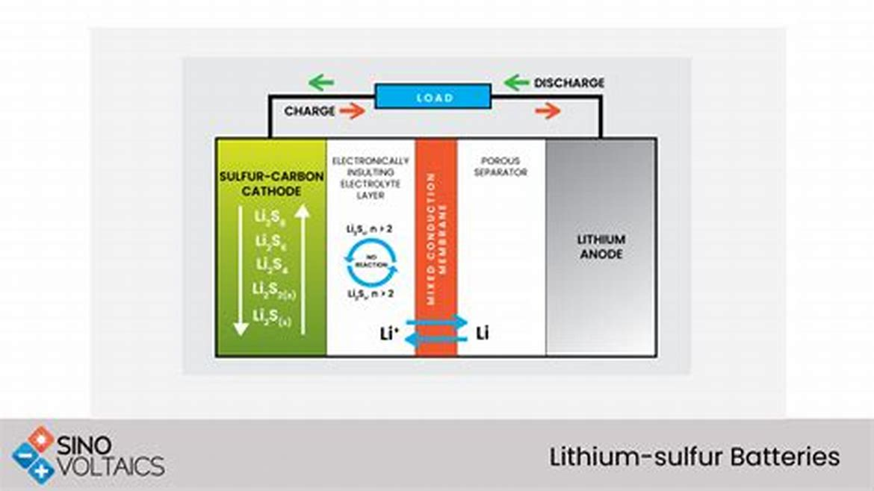



Research Directions and Industry Investments
Innovative Battery Materials
Circular Economy Practices
Integration of AI Technologies
Ongoing research focuses on developing new materials, such as lithium-sulfur and sodium-ion, which aim to enhance energy density and reduce reliance on scarce resources like cobalt.
Emphasizing recycling and repurposing, research initiatives are exploring methods to reclaim valuable materials from used batteries, thereby minimizing waste and promoting sustainable resource management.
The application of artificial intelligence in battery research is advancing predictive analytics for performance optimization, enabling smarter designs and more efficient manufacturing processes in the industry.

Slide 16

Thank You
Contact:popai@example.com

